Slide 1
Student Union research
Analysing features of SU website based on user and design requirements

Slide 2
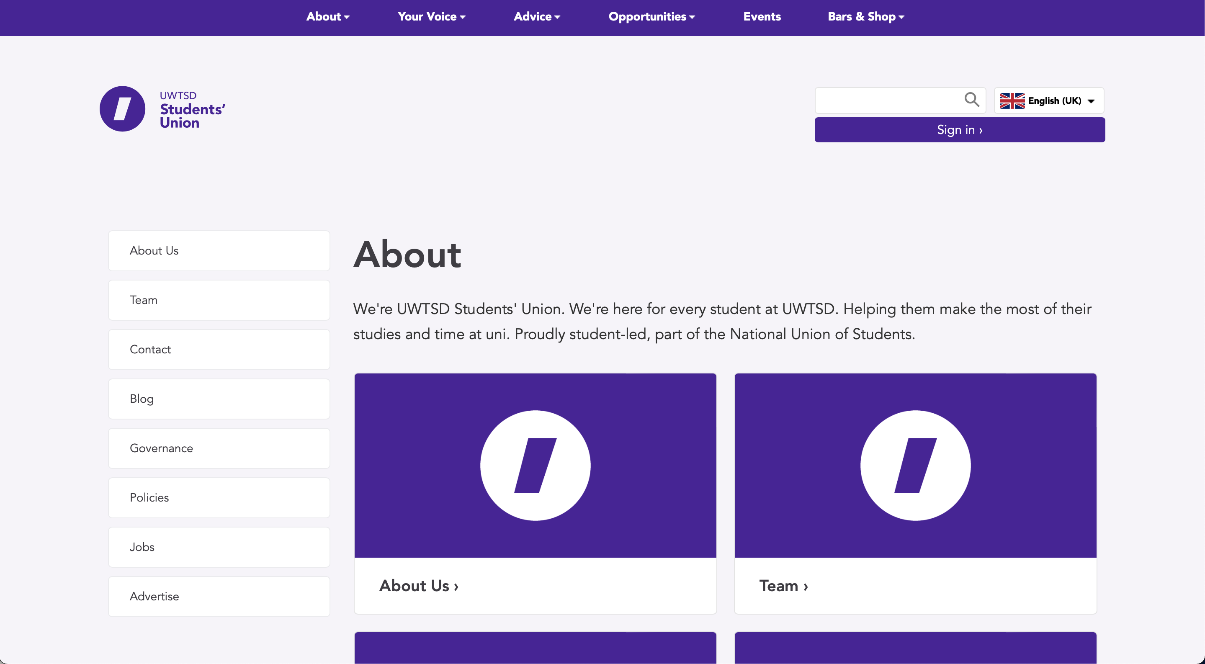
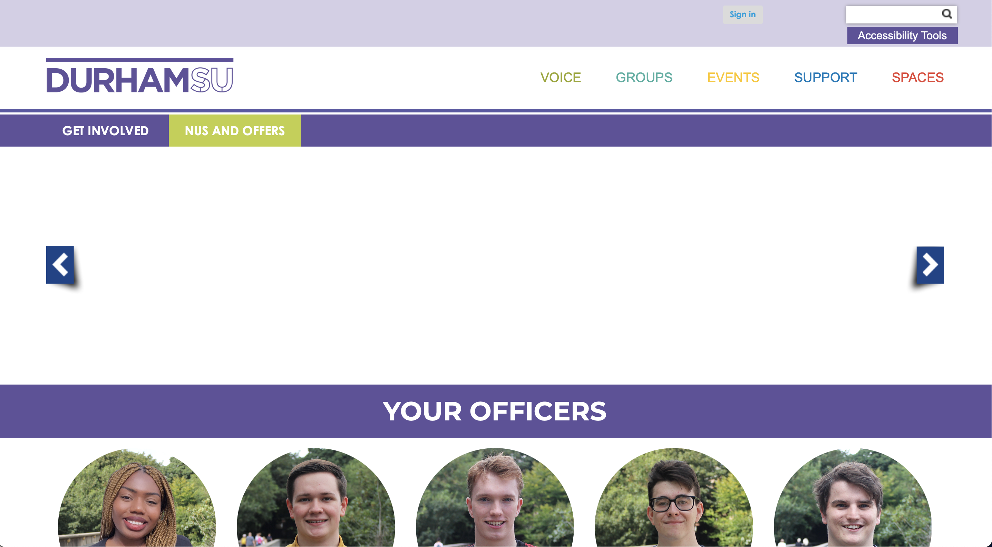
Layout Structure
Wales Trinity St. David University
Durham University
Simple, yet effective. Consistency throughout pages.
Nav left – Article right
Header unnecessarily large
Poor use of colouring
Nothing appears when clicked on the ‘NUS and Offers’
Clear headings - easy to distinguish between sub-sections

Slide 3
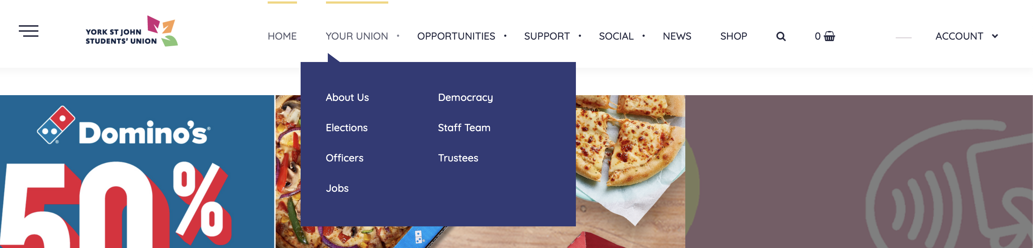
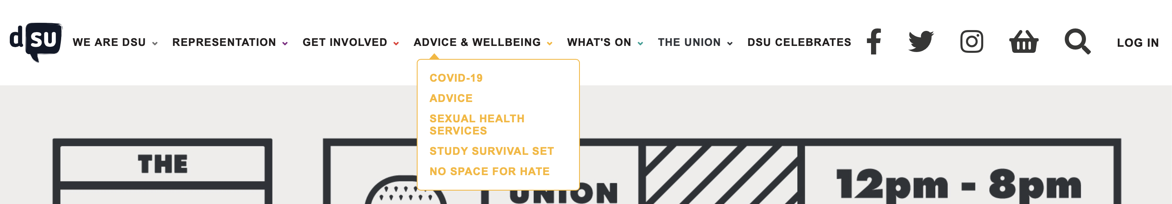
Navigation layout
York St. John University
De Montfort University
Navigation is clear, good use of headings and sub-headers
Small yellow bar above hovered navigation header
Colours are consistent
Navigation headings are clear – easy navigation across website
Different colours on drop downs are unnecessary

Slide 4
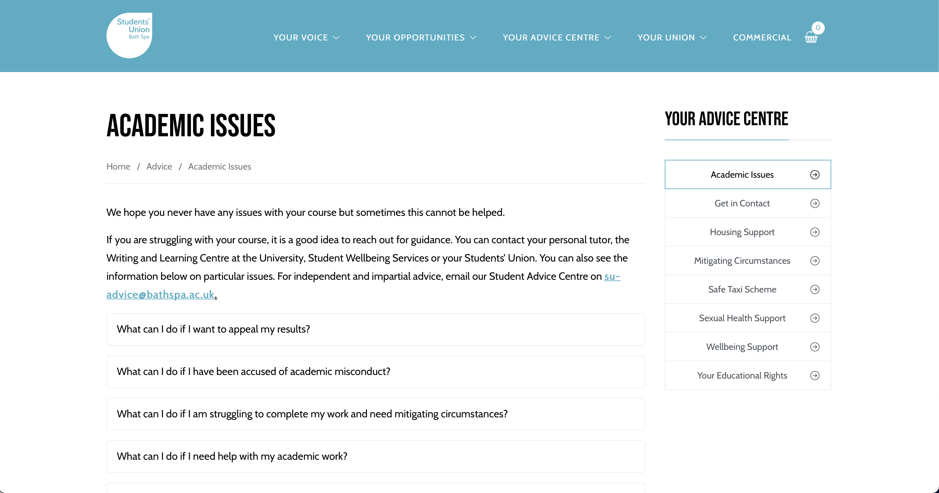
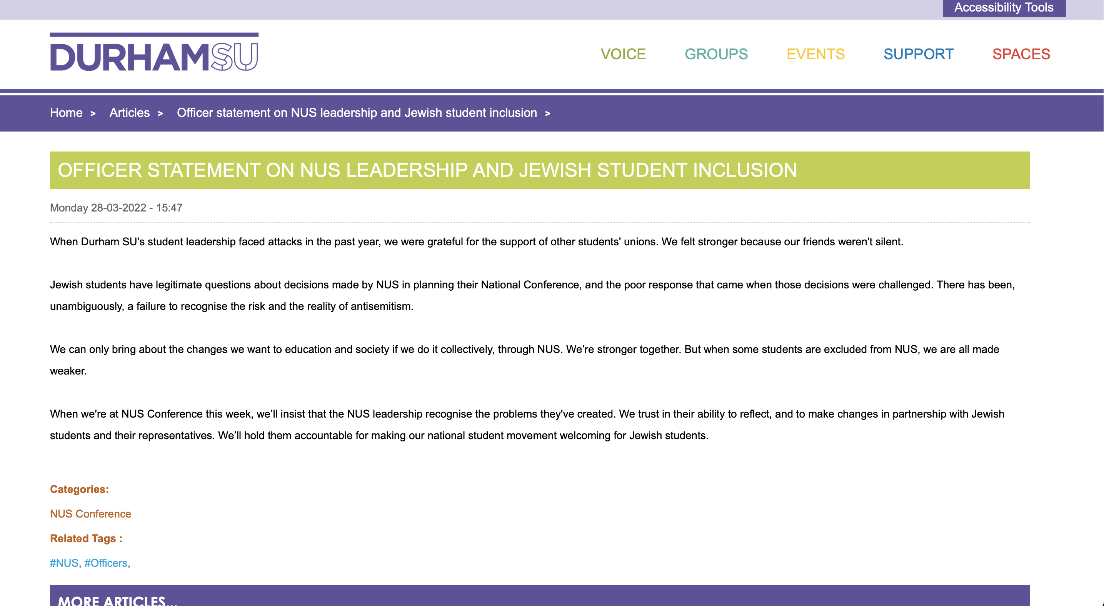
Content
Bath Spa University
Durham University
Headings and text body are clearly set out – good font size, text is easy to read
Content spans across the whole width of the page, difficult to read

Slide 5
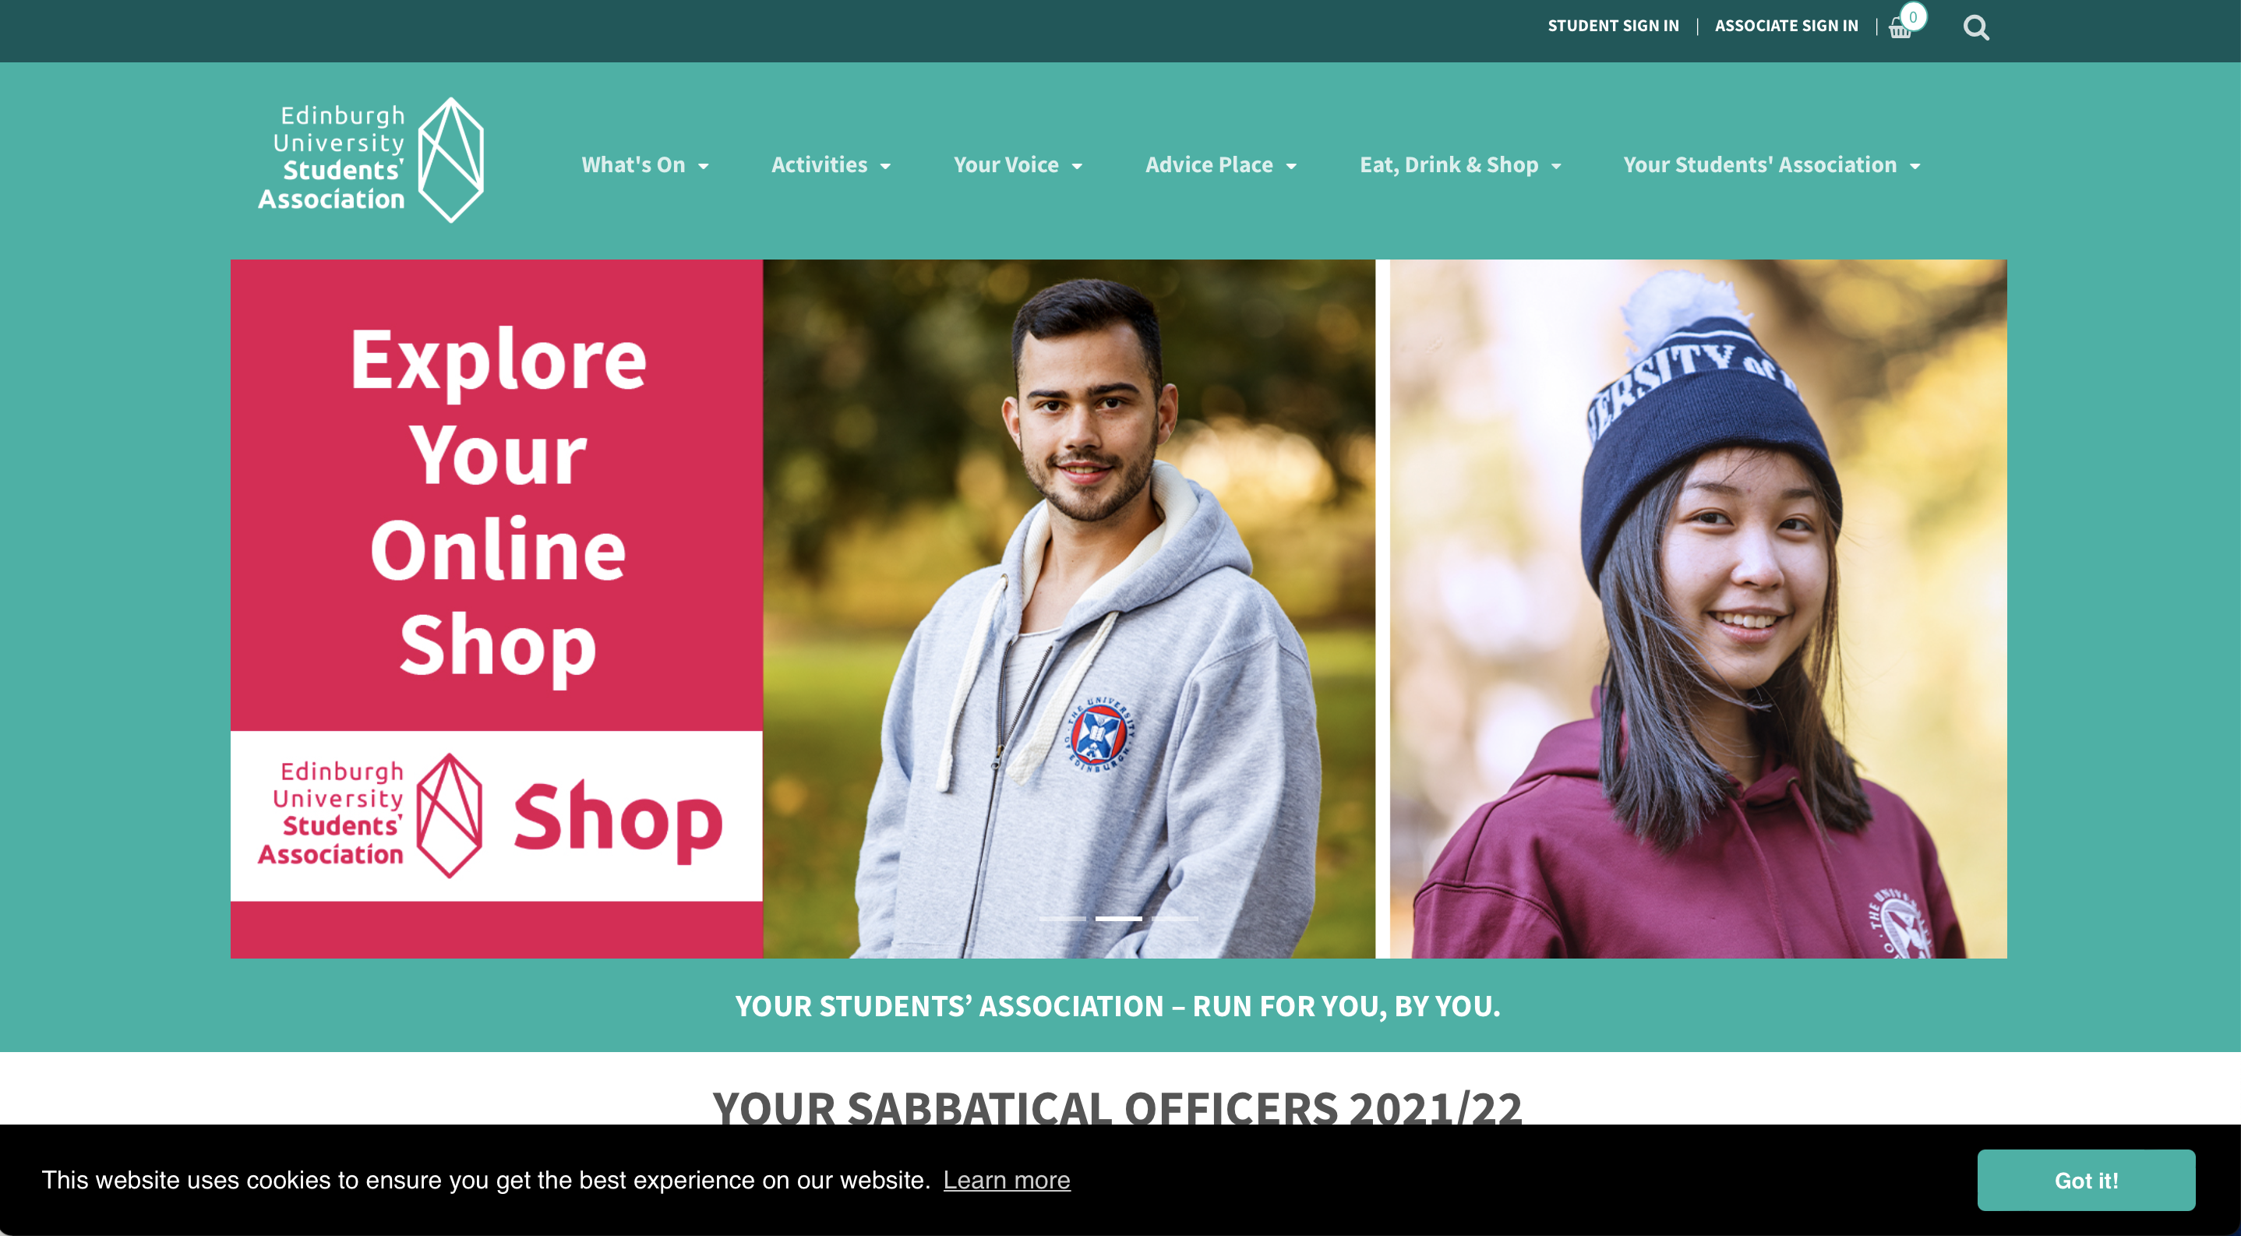
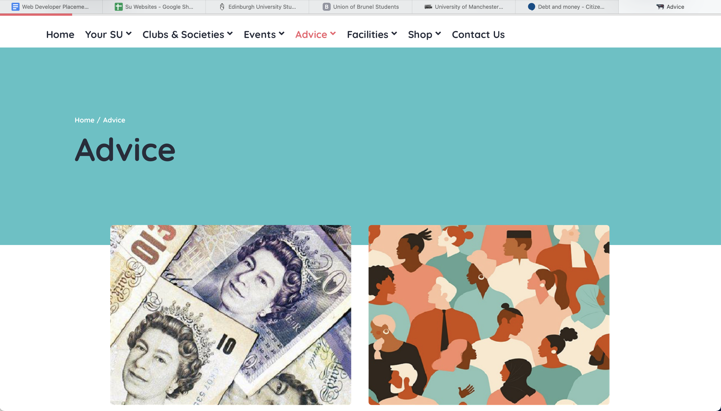
Features I like
Edinburgh University
Royal veterinary College
I like the way they’ve used the carousel here, not invasive – integrated well with the
I like the ‘progress’ bar at the top of the page, subtle, but a nice addition to the website

Slide 6
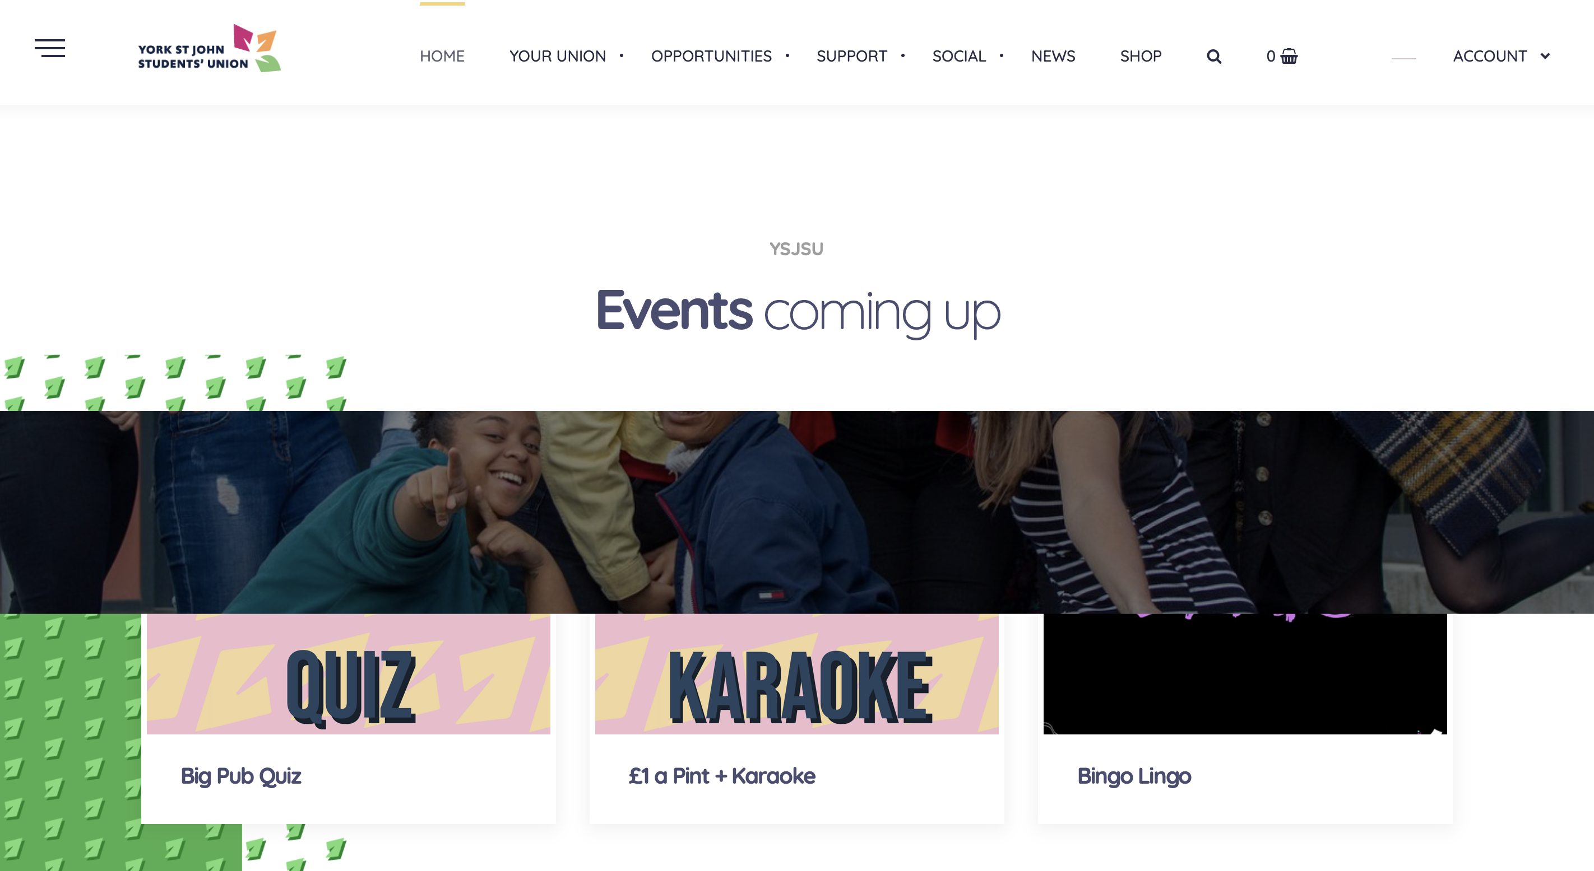
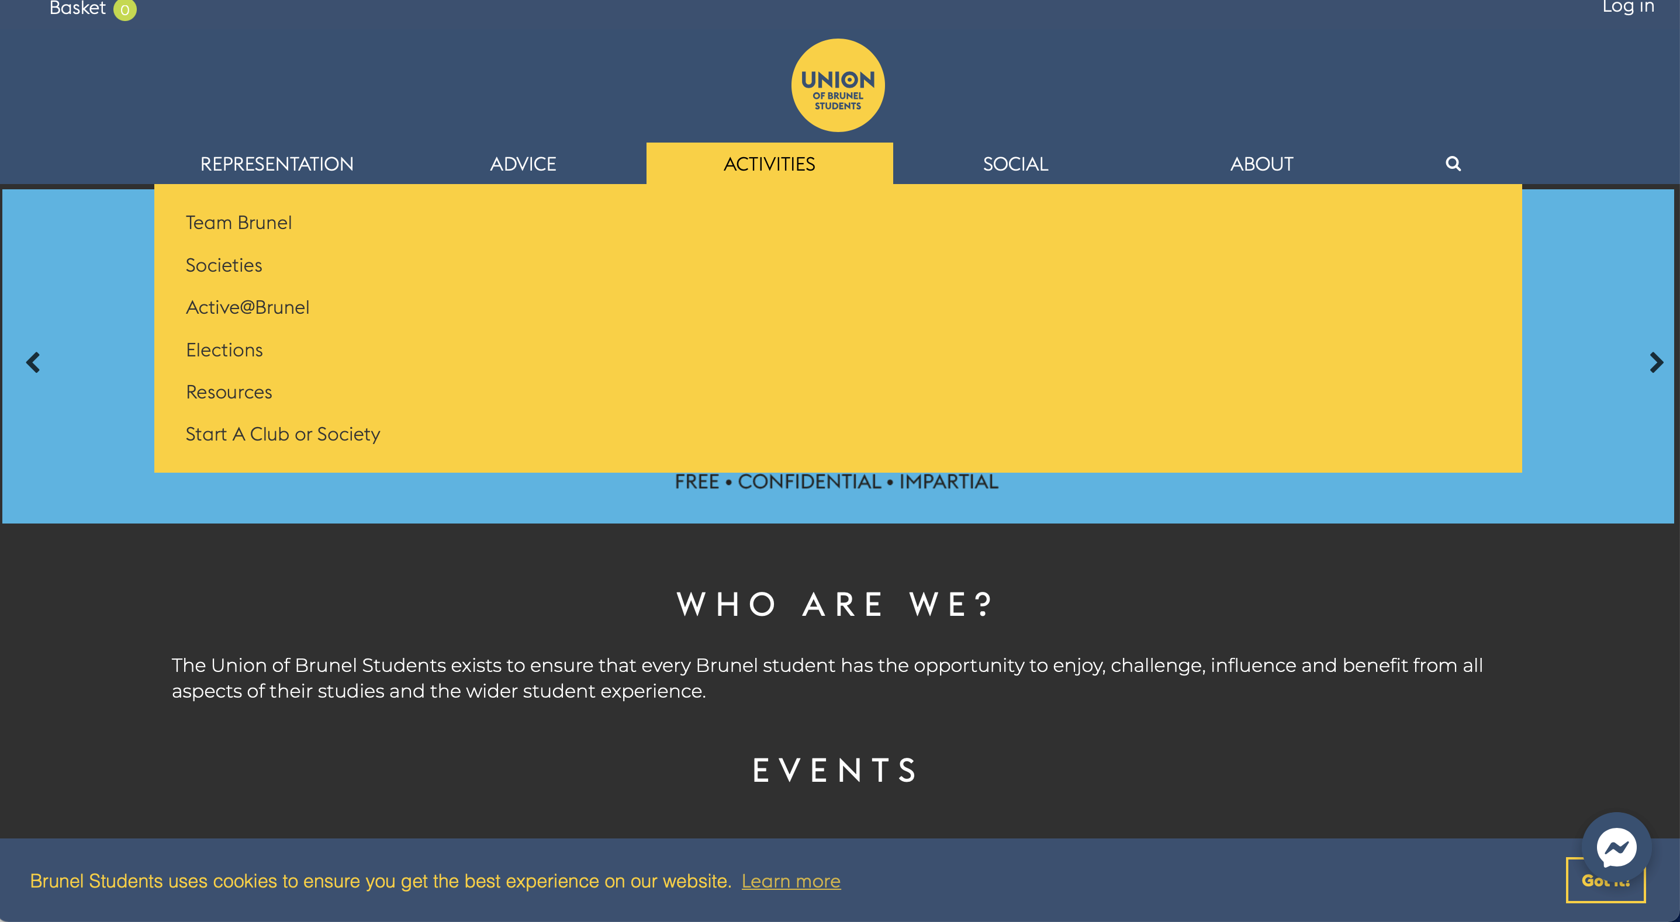
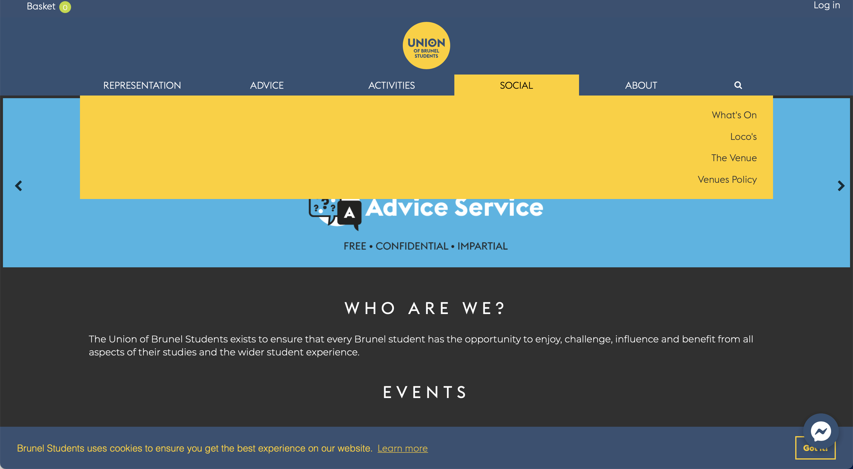
Features I do not like
York St. John University
Brunel University
Text shifts depending on which heading is selected
Image scroll overlaps the information of that section
unnecessary

Slide 7
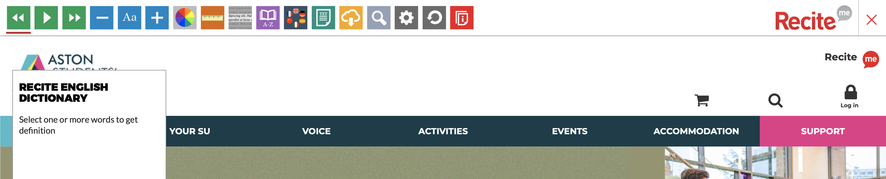
Accessibility
Aston University
Important feature I think all websites should offer, allows for text to speech, background colour change, etc.

Slide 8
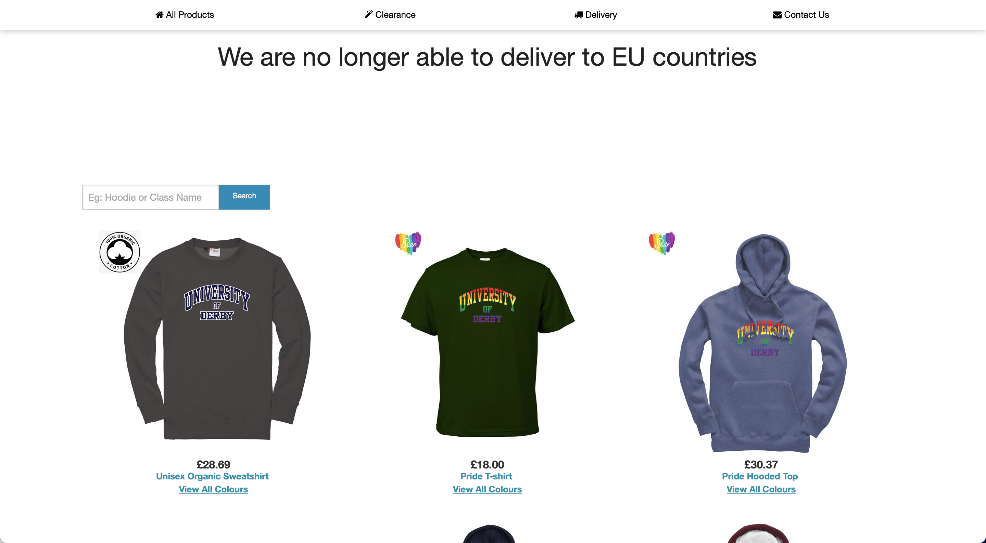
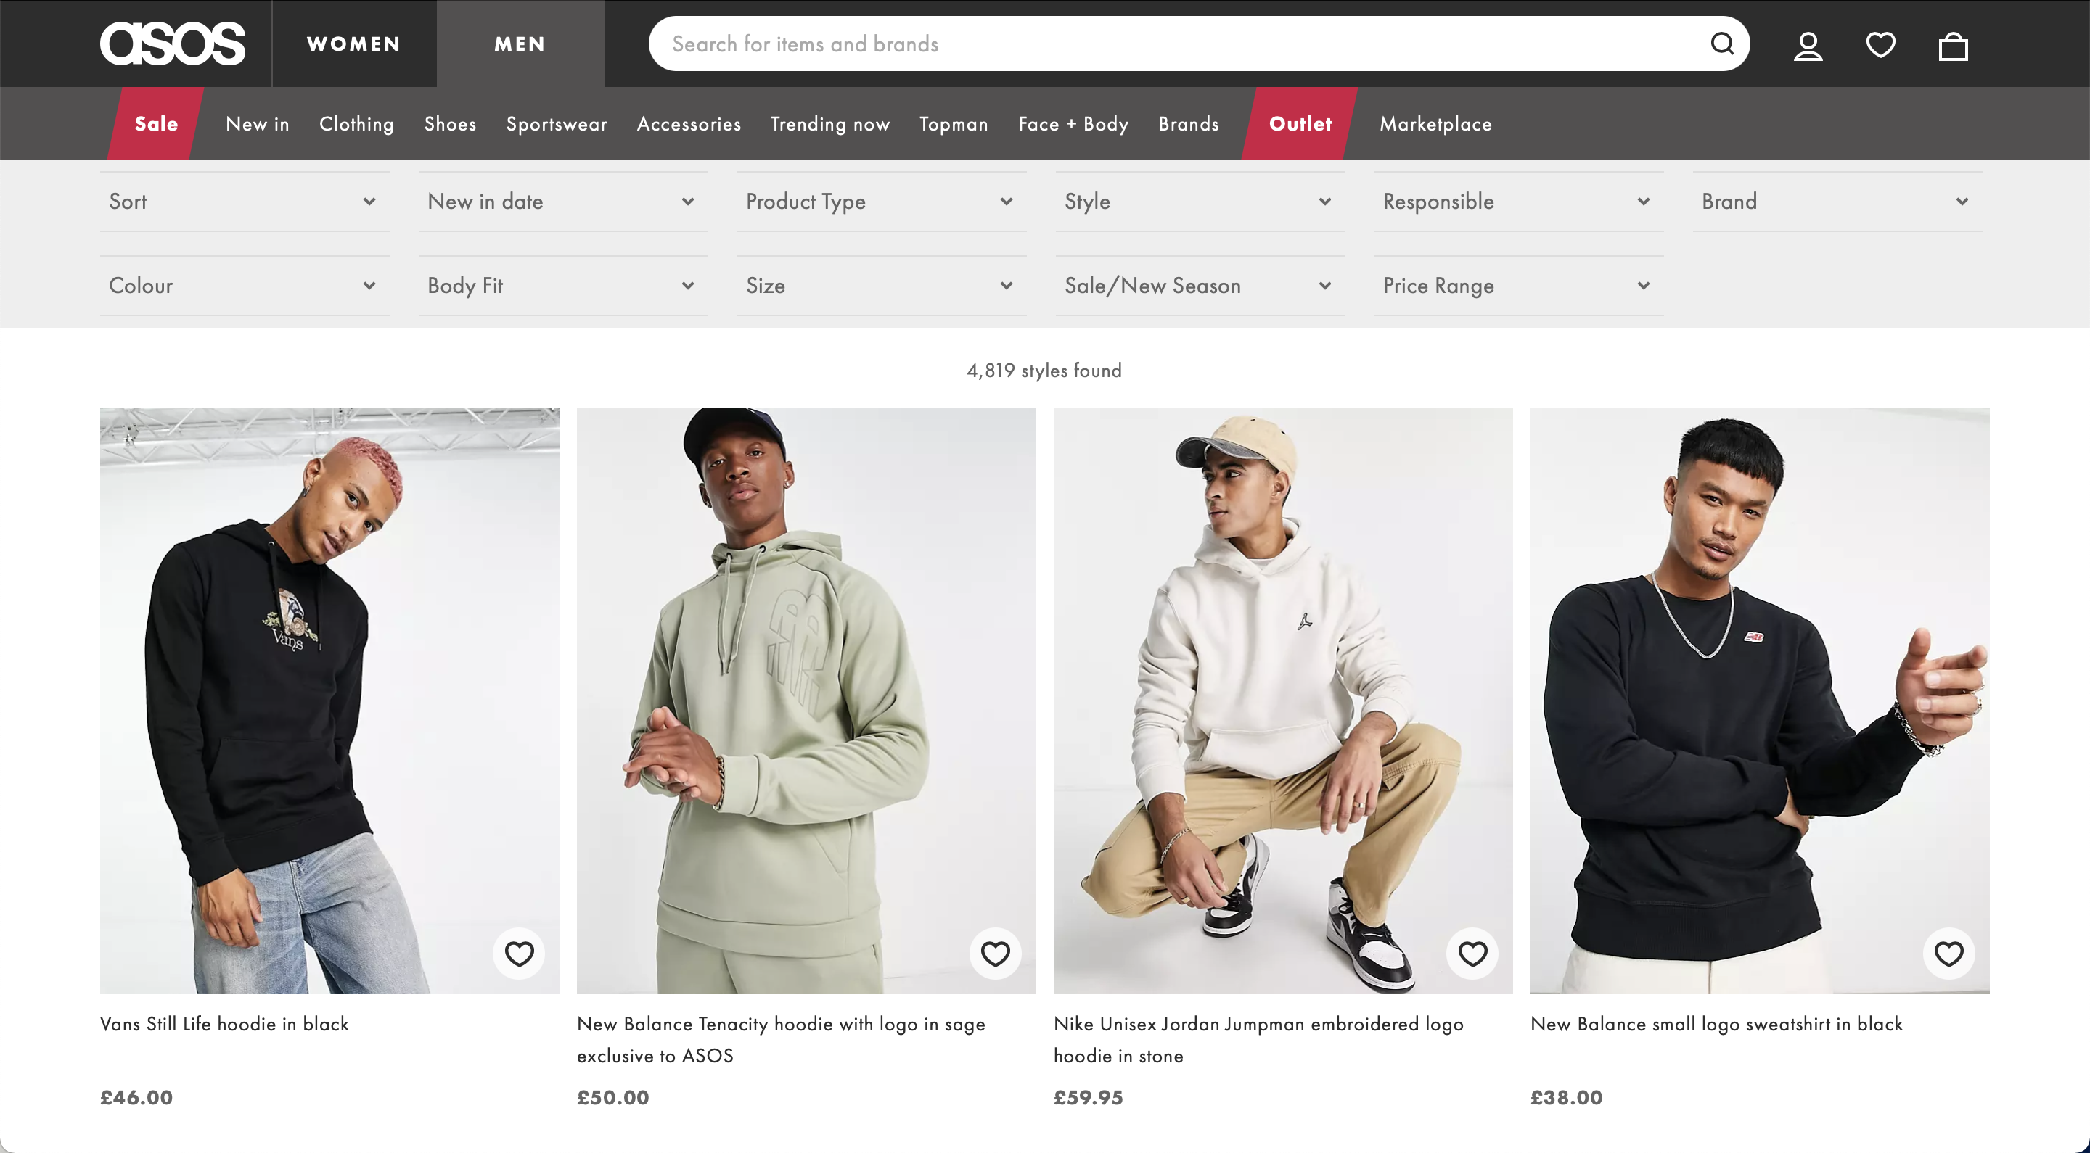
Comparison to non-SU websites
Derby University SU shop
ASOS

Slide 9
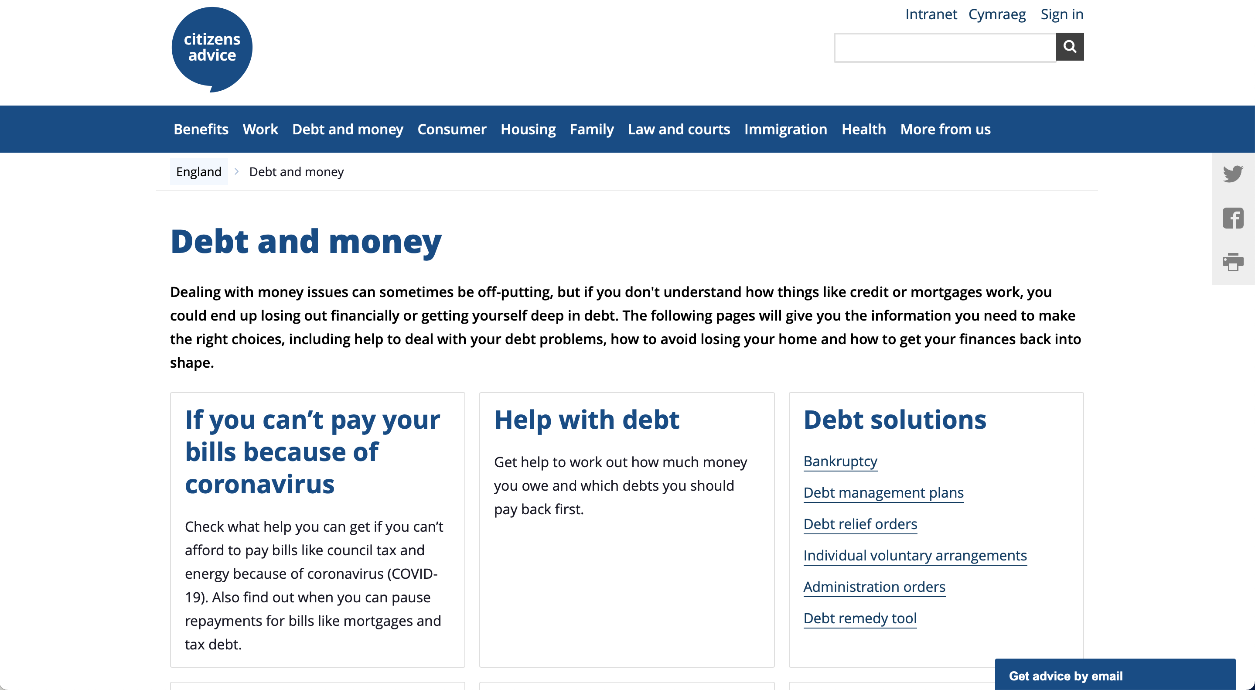
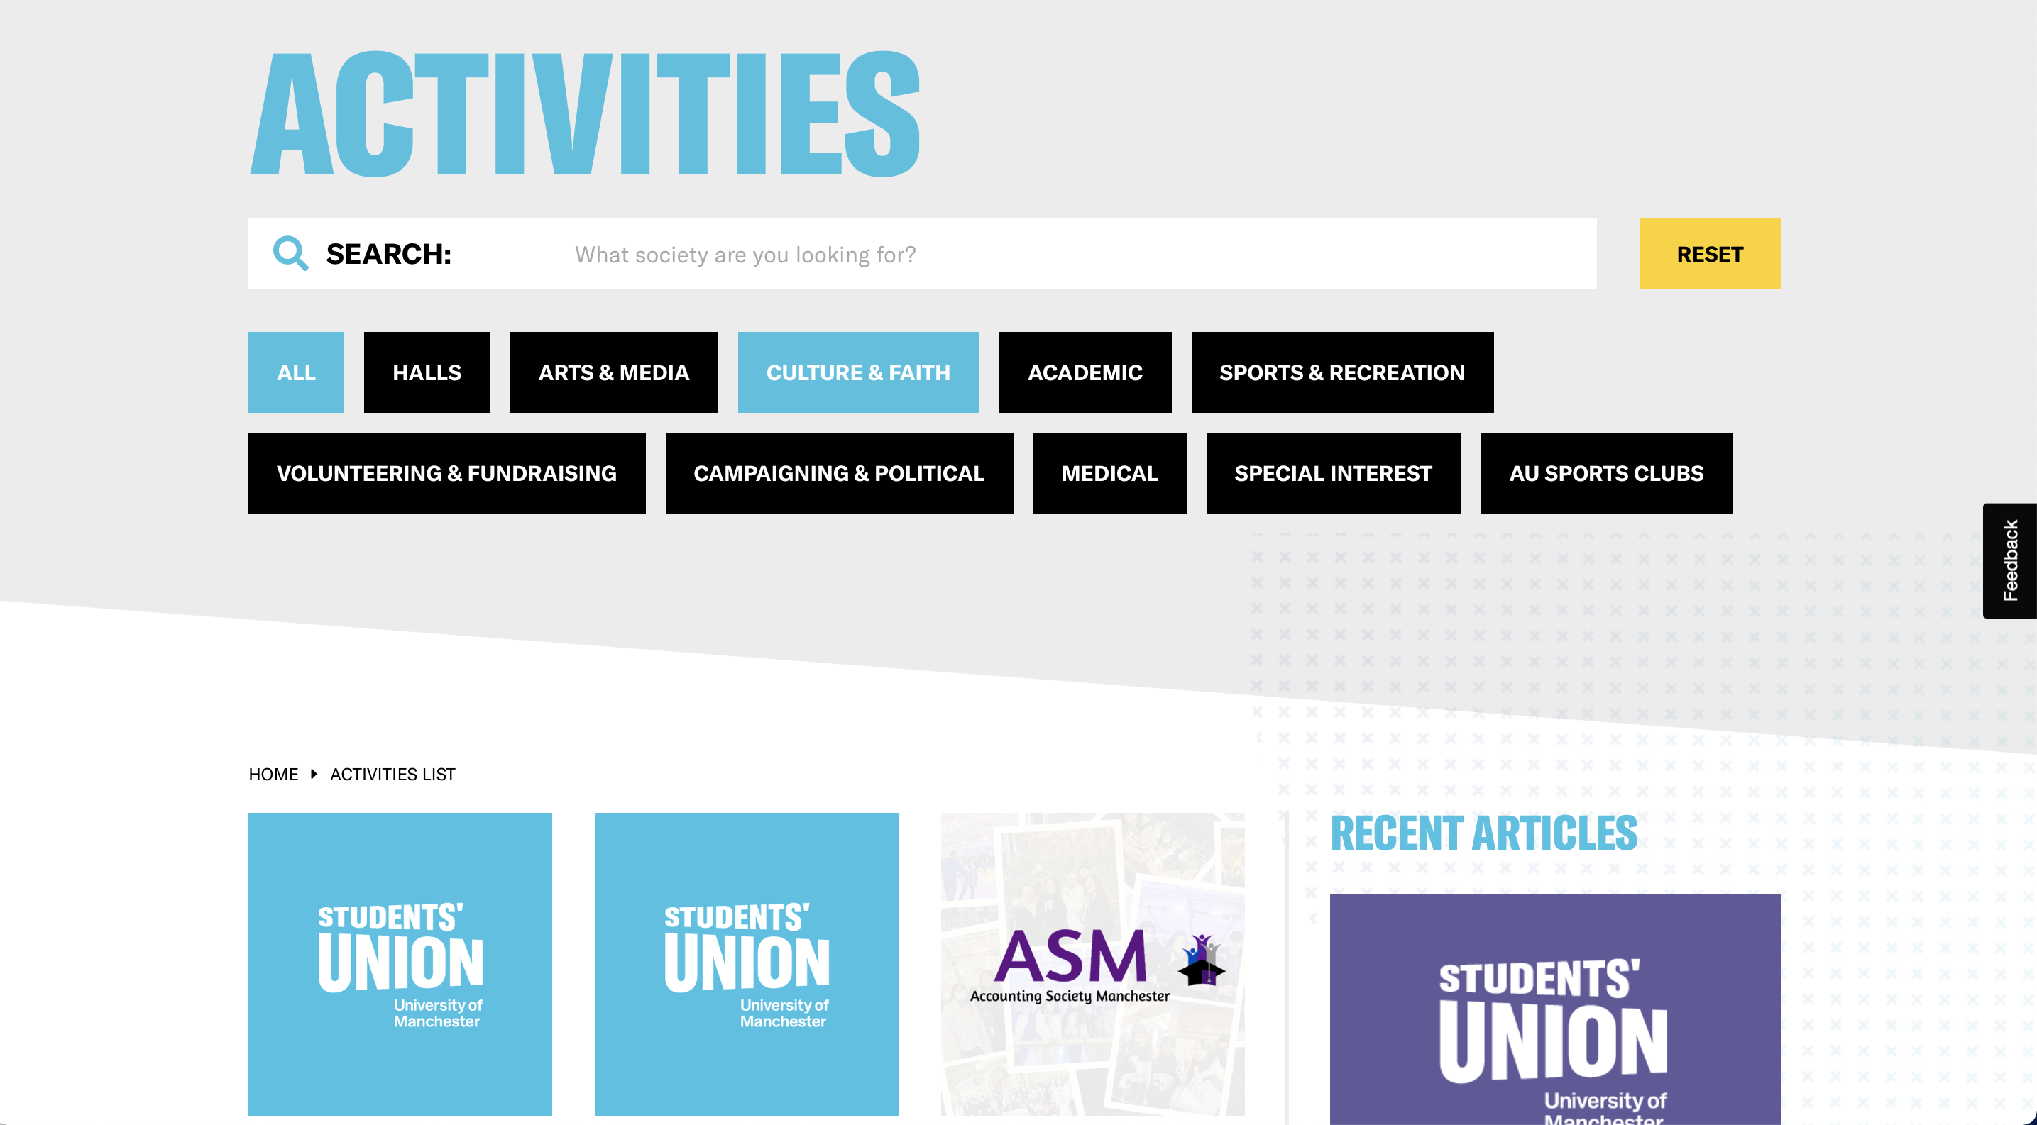
Comparison to non-SU websites
Citizen's advice
Manchester University

